Slide 1

Robo AI – Chatbot Indonesia AI PJ
PIC NLP Tech (Angga, Adam, Mardadi)
Sabtu, 1 May 2021

Slide 2
Robo AI

Slide 3
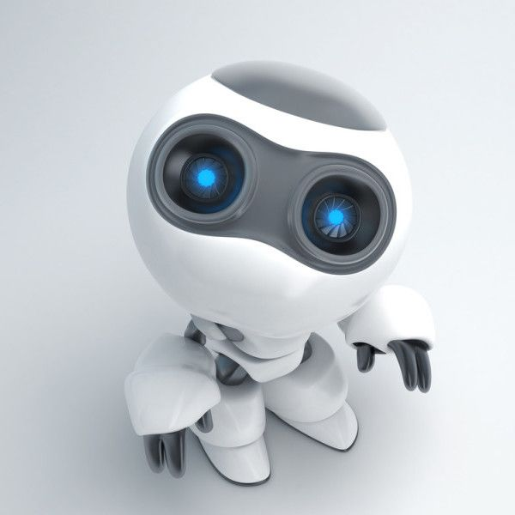
Robo AI
Brief Description
AI-Based Chat Bot powered by Indonesia AI Team to support AI Mentorship and overall activities in organization. It is named Robo AI.
Main Goals
To provide all information related to organisation
To motivate everyone (core team, mentor muda, mentee, registered members) to keep everything up in community
To become AI information centre for everyone in community

Slide 4
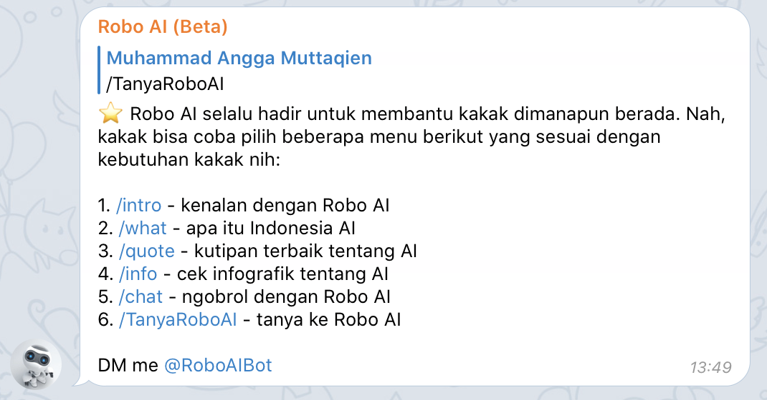
Robo AI
Specific Features
Profile Information
Motivation
Quiz
Analytics Dashboard
NLP Breakthrough
DM me @RoboAIBot

Slide 5

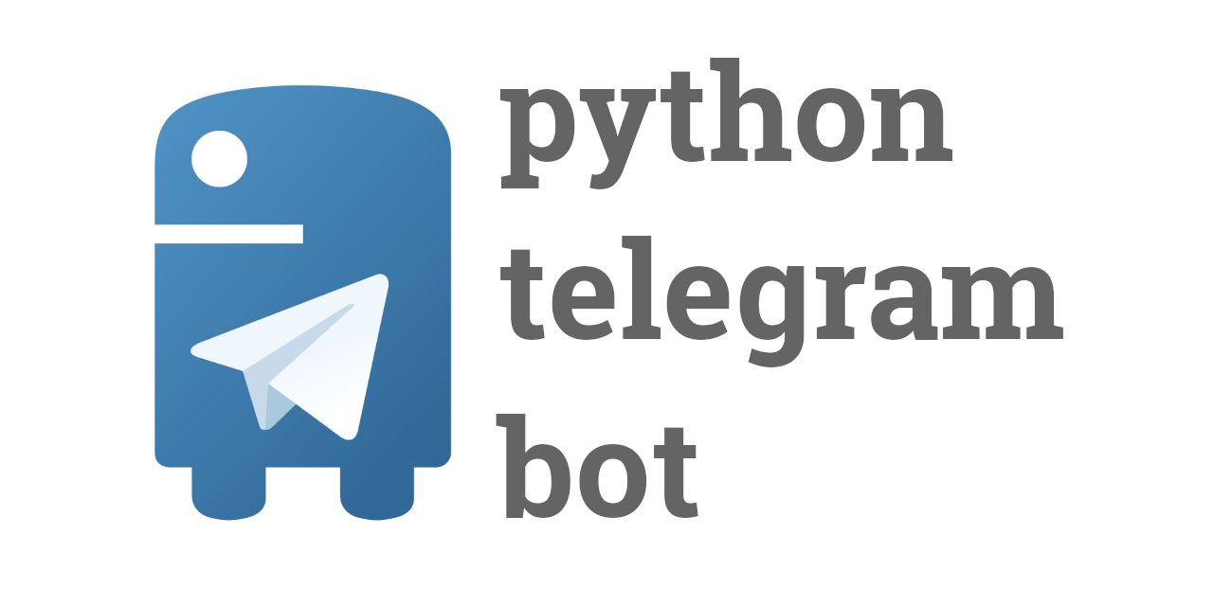

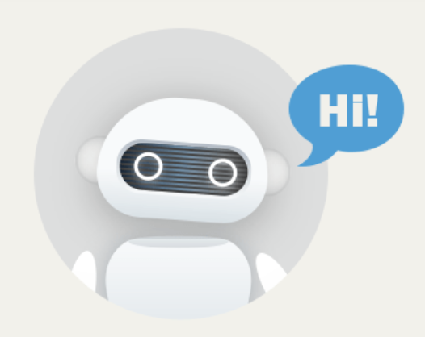


Robo AI
What does make bot is good bot?

Slide 6
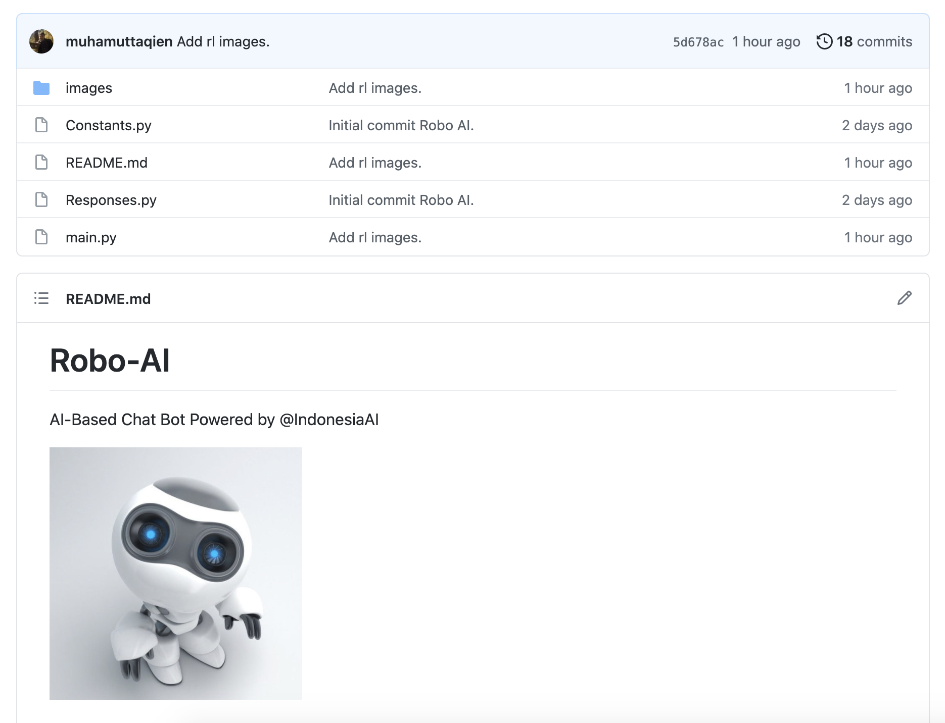

Robo AI
Indonesia AI Github

Slide 7
Robo AI
Team
1. Angga (Lead)
2. Adam
3. Mardadi
4. Andre
5. Hari
6. Hendra
7. Alfon
Timeline
Early period (May - August): Automatic Chatbot
Late period (August – February 2022): Smart Chatbot

Slide 8
#RoboAI #SmartAIChatBot

